Slide 1
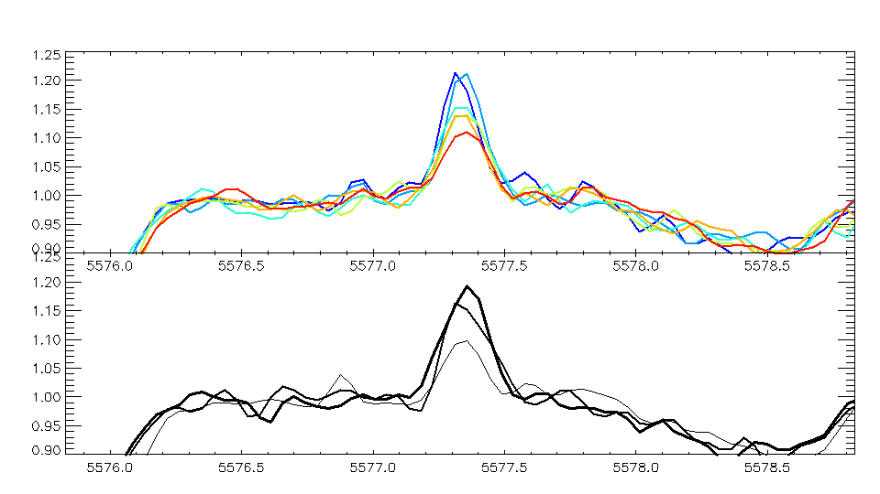
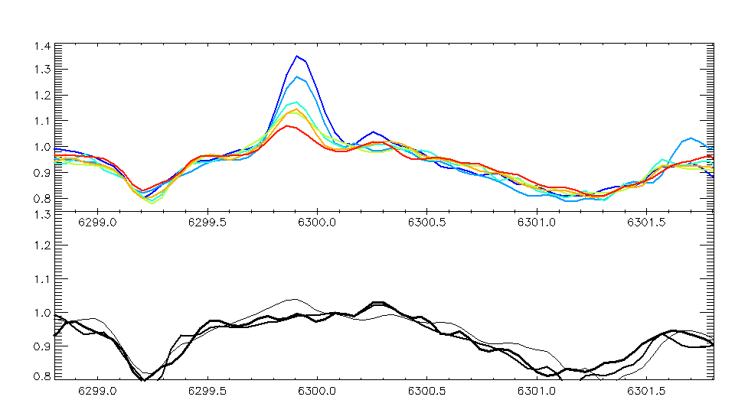
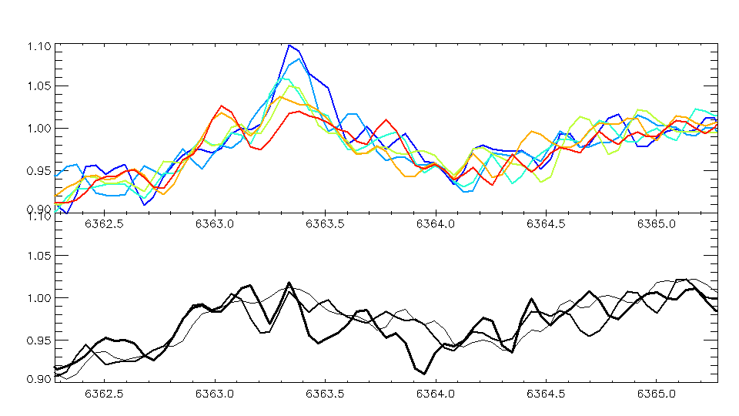
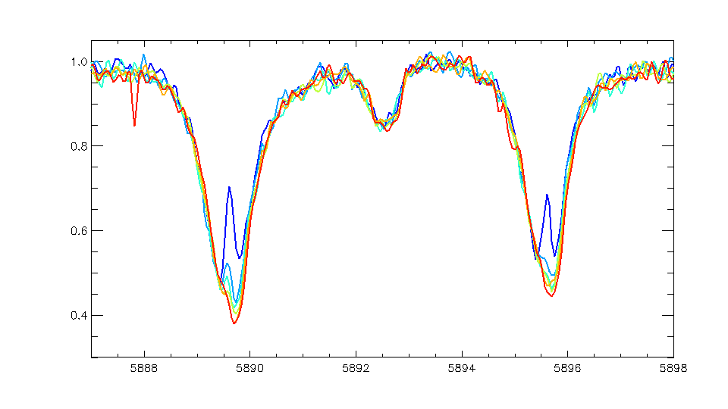
Normalized to unity, things look like they’re changing…
Tells us the Jupiter scatter brightened by ~2x as we tracked towards its limb
Decreases by 3.5x to 4x → A real decrease at Io of only ~1.5x to 2x since Jupiter scatter is getting brighter.
Io
Earth
Io
Earth
No Io in the black lines below, just sampling the Jovian scatter at different distances from the limb
Earth
Earth
Io
Rapid plunge! Volcanoes + torus electrons cannot be creating this sodium.
Curious if this falloff matches the SO₂ collapse in Tsang et al (2015)? If so, perhaps SO₂ collisions support the Na atmosphere. Model Grava et al. (2014) vs SO₂?

Slide 2
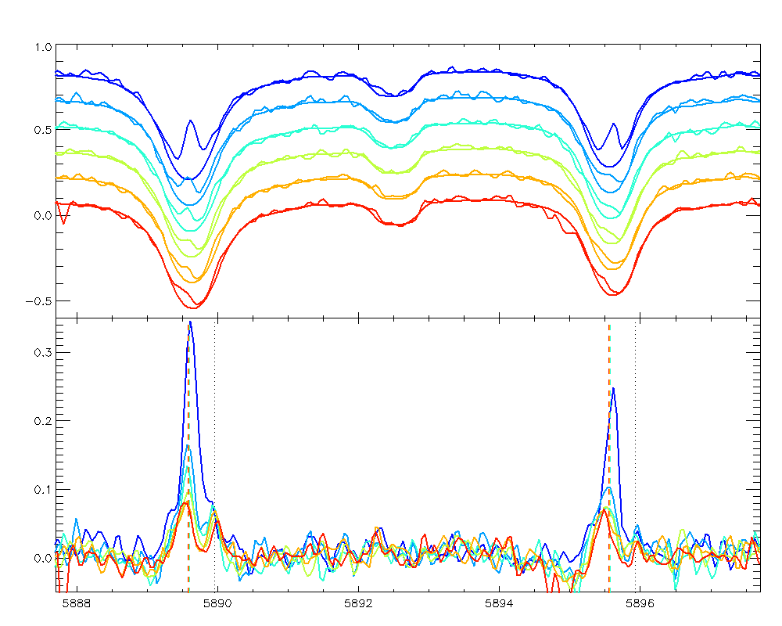
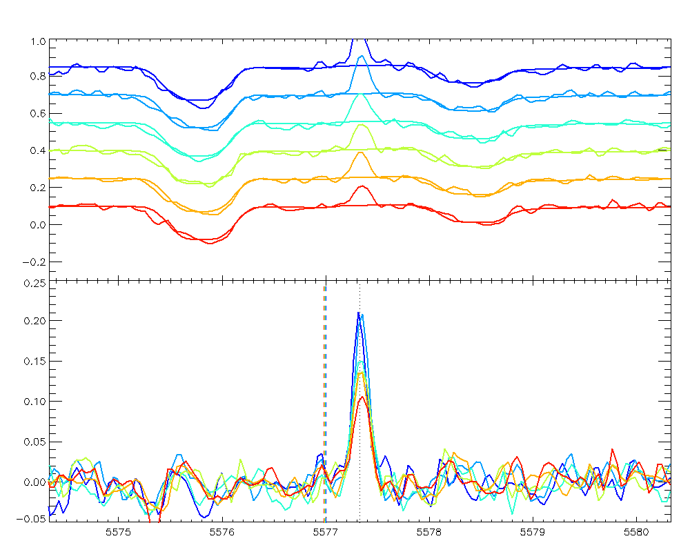
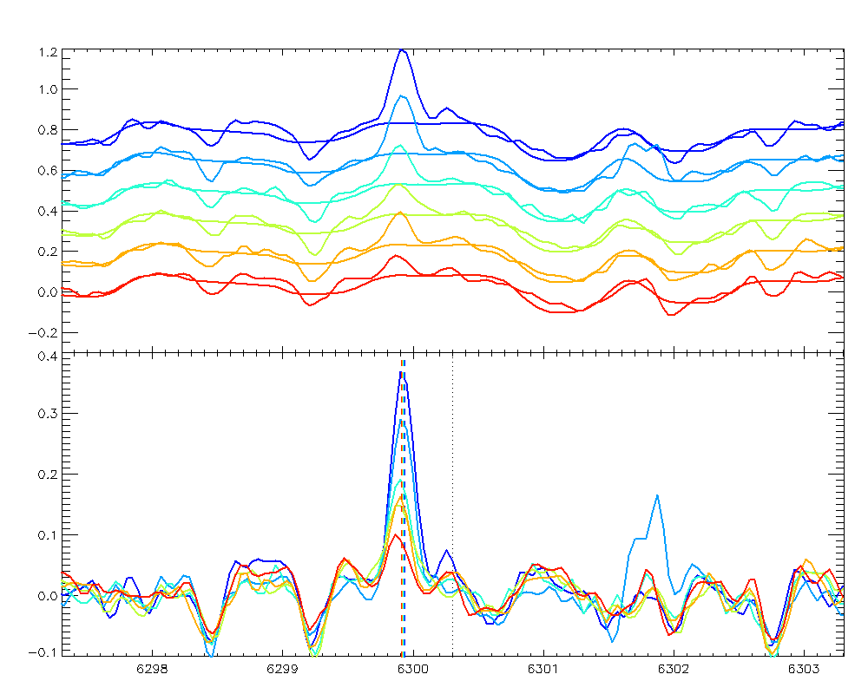
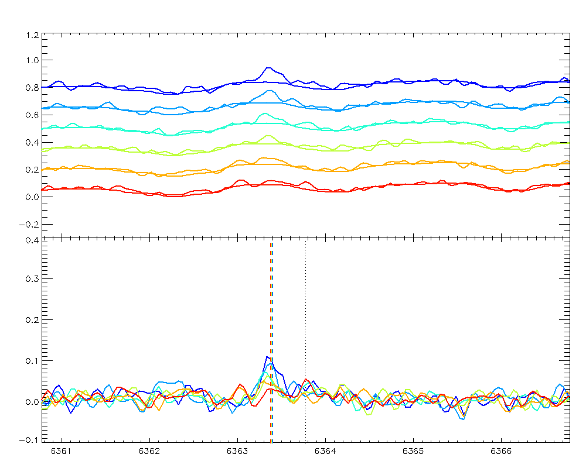

Slide 3
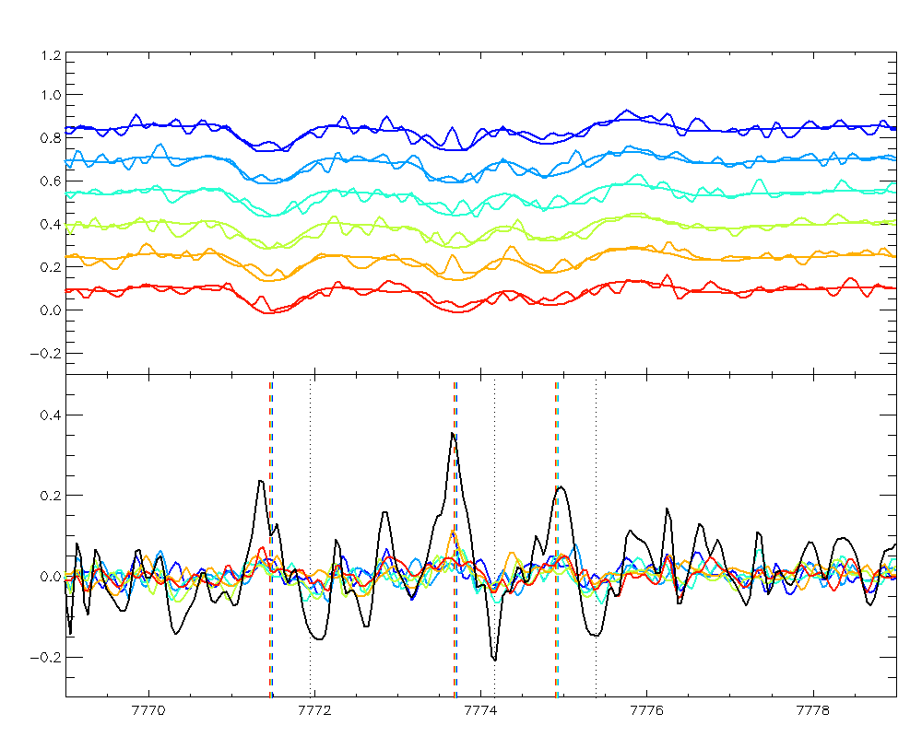
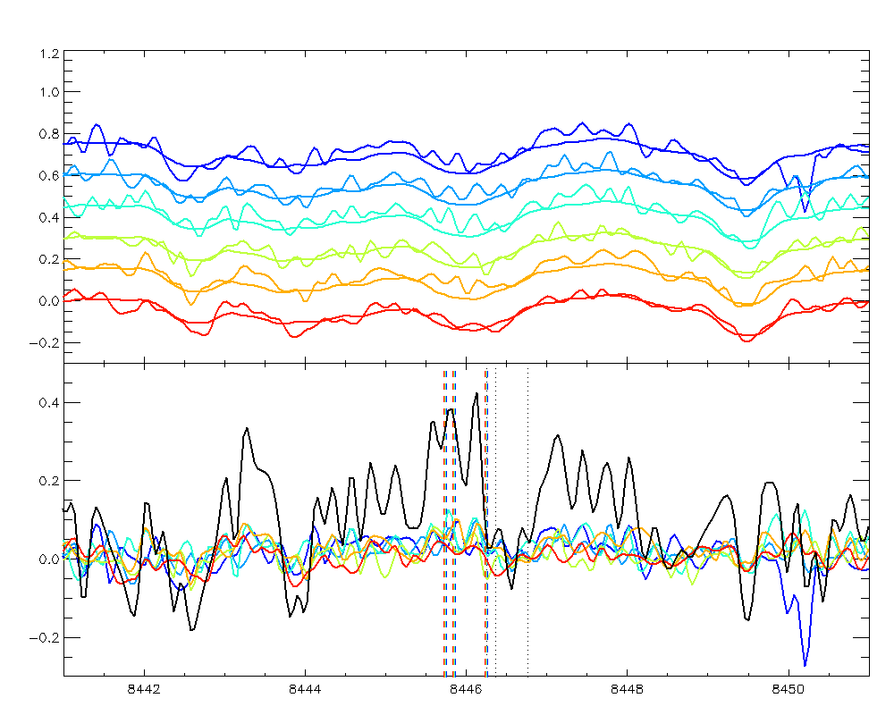
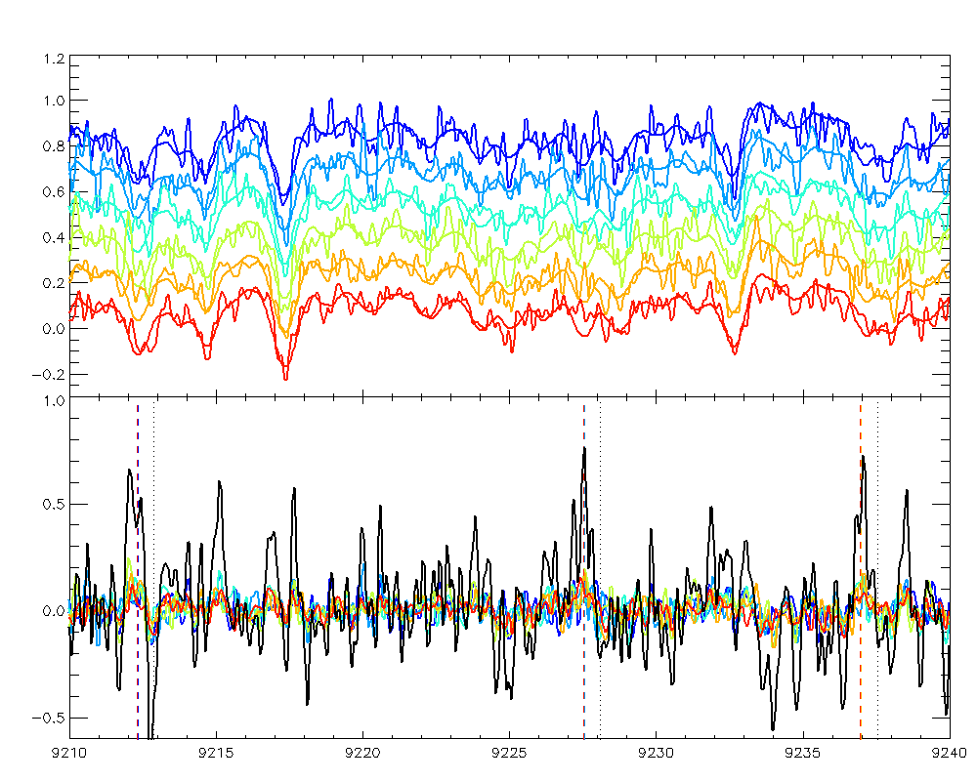
O I triplet 10.7 - 9.1 eV allowed transition
The plots below also apply smoothed and shifted Jupiter-disk spectrum to subtract off Jovian scattered light. If we co-add the residual, hints of allowed O I and S I triplets are there. Here are the 3 brightest multiplets that Ajello et al. (2008) measured from 25 eV electrons impacting SO₂. These seem promising.
S I triplet 7.9 - 6.5 eV allowed transition
O I triplet 11.0 - 9.5 eV allowed transition

Slide 4
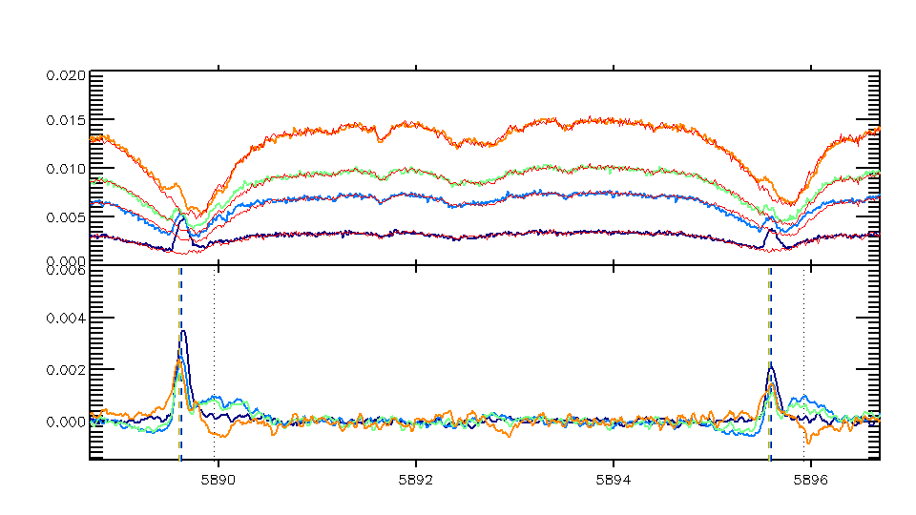
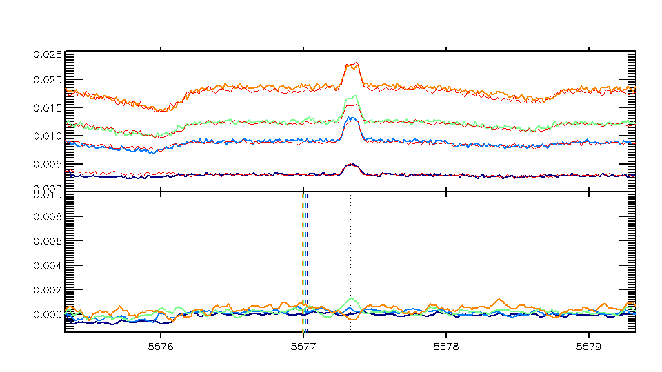
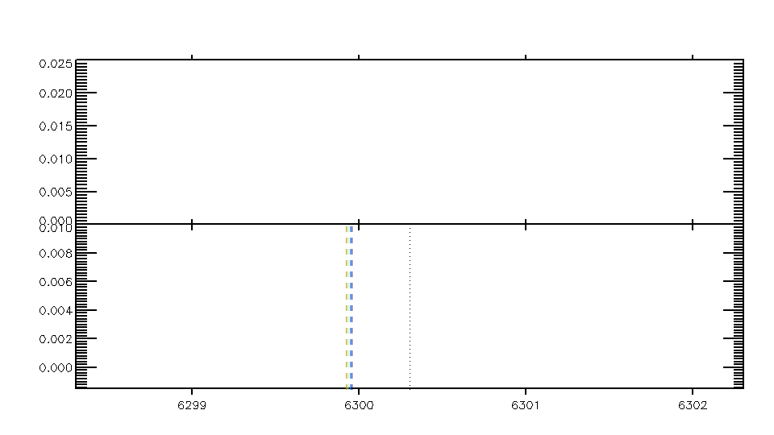
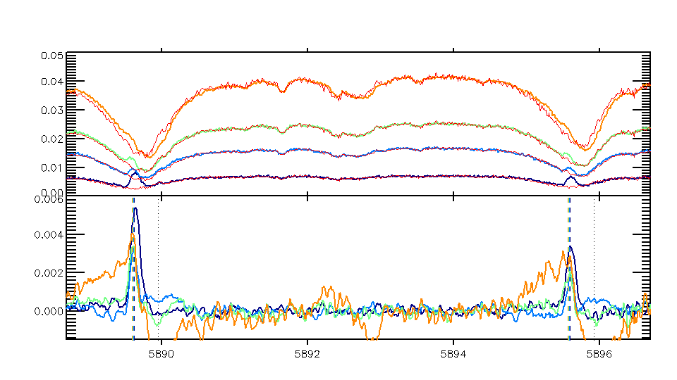
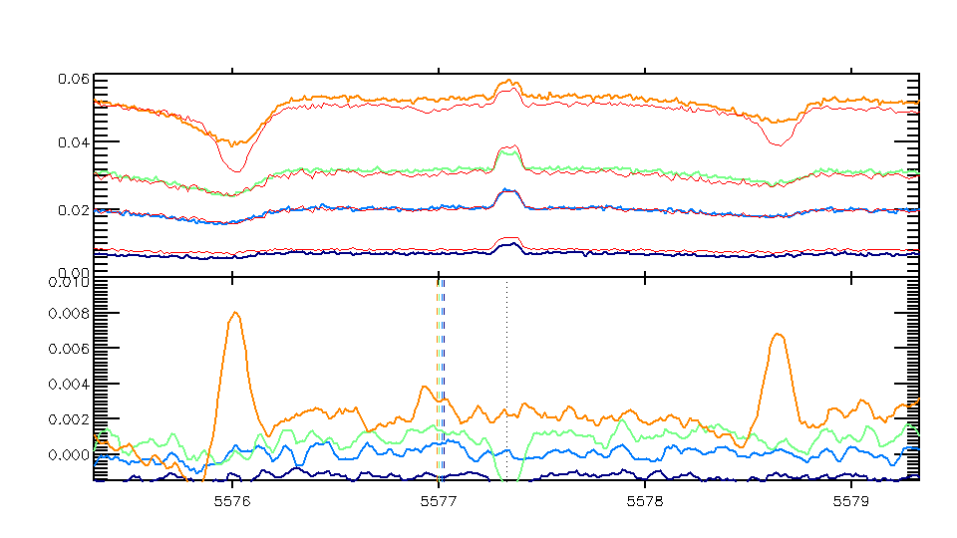
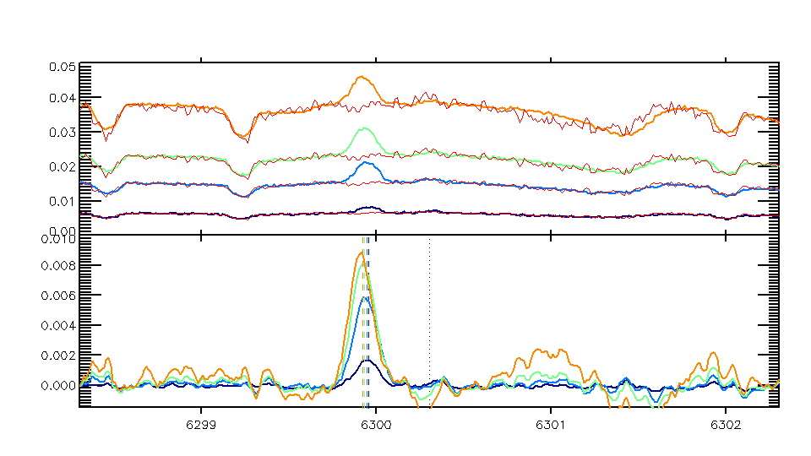
LBT First Look April 24th Io Eclipse

Slide 5
LBT First Look April 24th Io Eclipse

Slide 6
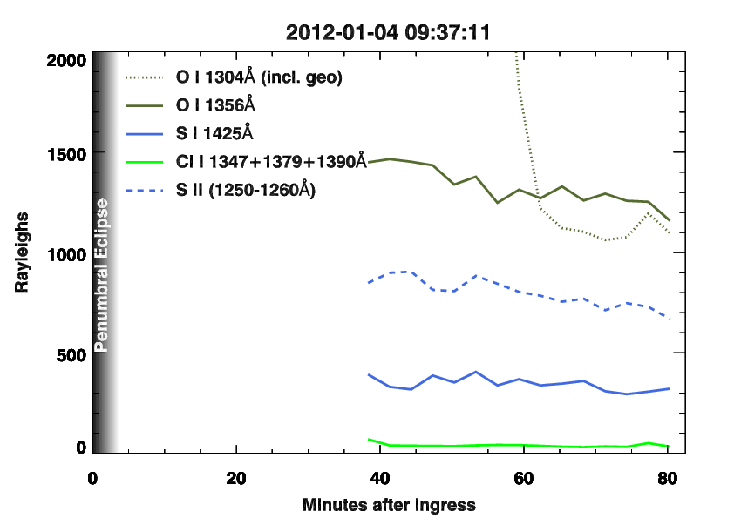
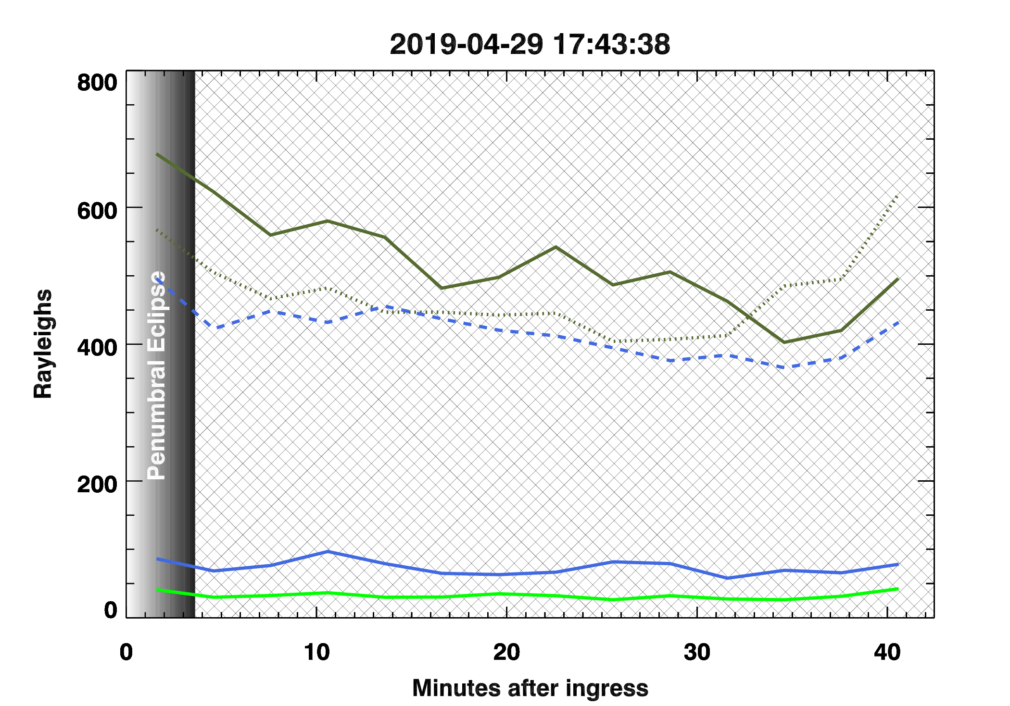
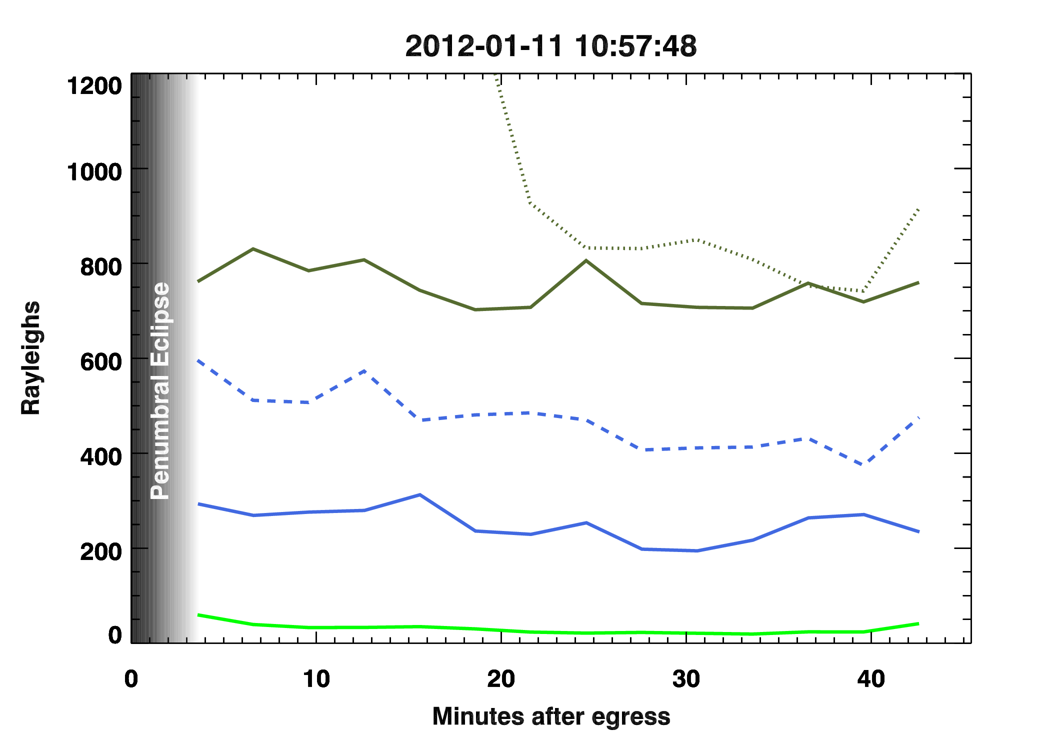

Slide 7
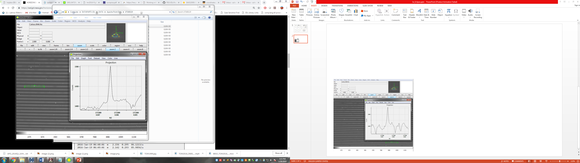
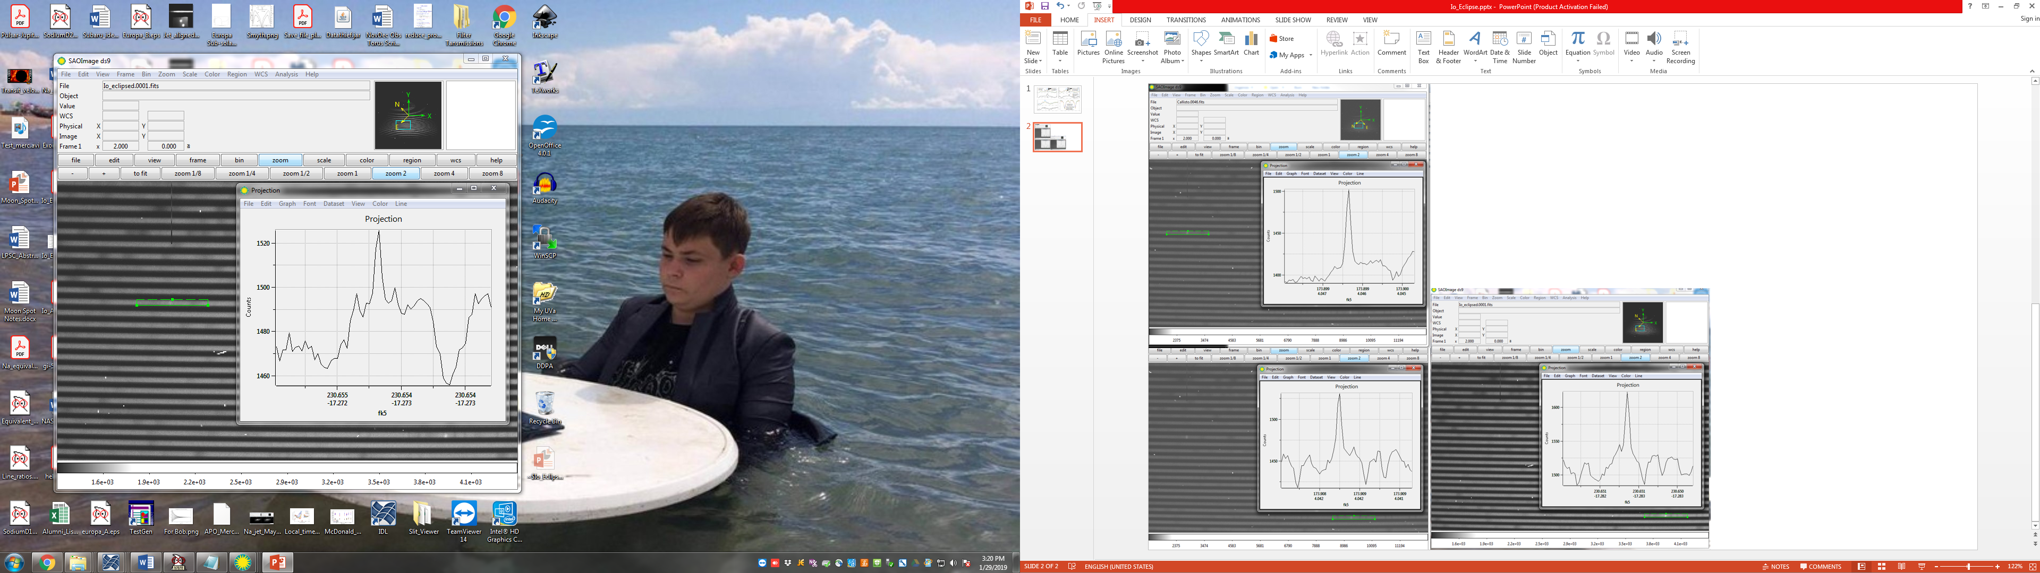
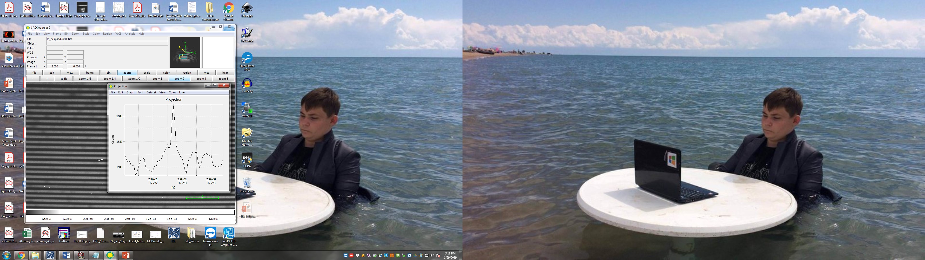
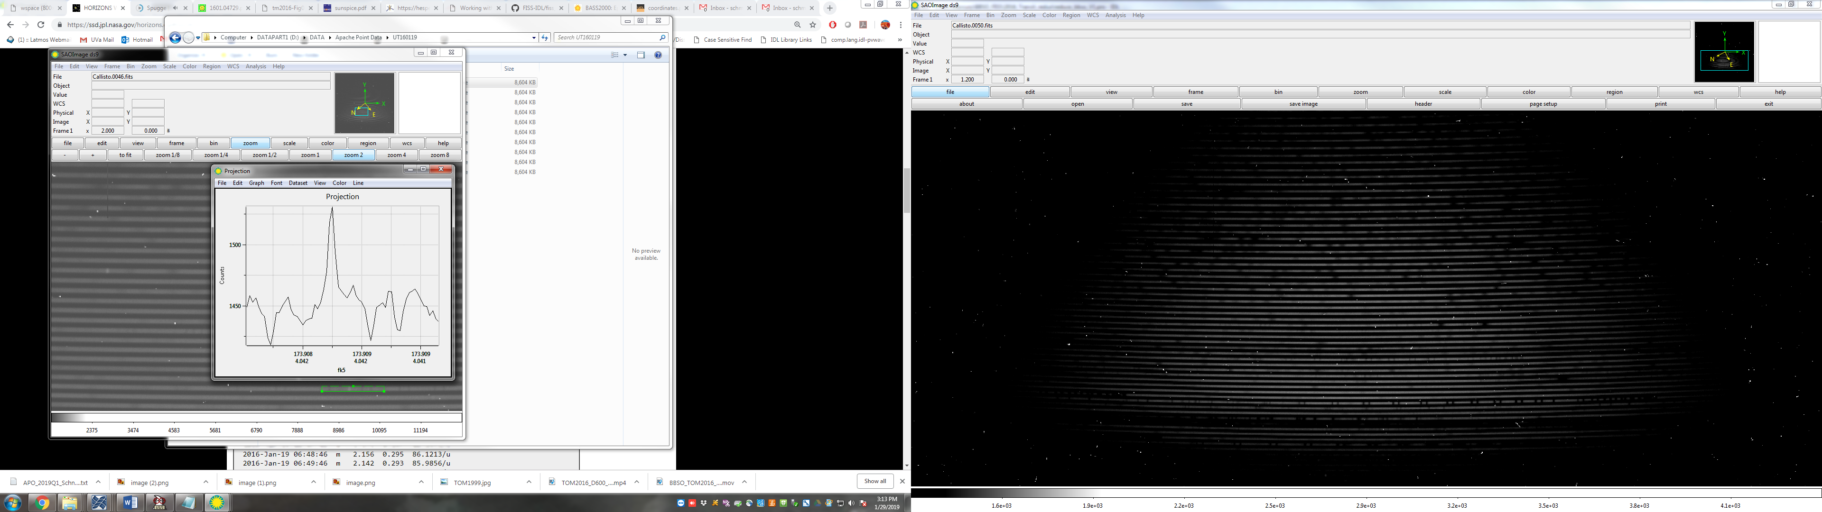
Callisto -21.58 km/s
Io -17.8 km/s

Slide 8
Sodium and Oxygen, 0 - 35 min ingress into eclipse, March 20, 2018

